Slide 1


Leonardo Gomes Cardoso
4 March 2022

Slide 2

Outline
Executive Summary
Introduction
Methodology
Results
Conclusion
Appendix

Slide 3
Executive Summary
The commercial space age is here, companies are making space travel affordable for everyone. Despite many companies trying to make this age happen, SpaceX is the most successful. Thanks to the reuse of the first stage of the rockets, SpaceX launch its rockets at US$ 62mm each, relatively inexpensive near your competitors.
To do that, we scrap the data from SpaceX from its API and from Wikipedia, wrangling the data through SQL, build some EDA and visualization tools and compare multiple Machine Learning algorithms, like logistic regression, SVM, decision tree and KNN. All models had this hyperparameters optimized by a GridSearch methodology.
Based in SpaceX information we can estimate with 89% of accuracy the chances of the first stage be reusable, which reduce the flight costs, and set the main features that make this happen. We also find a strong relationship between the launch site and the successful rate, and the same for payload mass. Some orbits has best successful rate, and we can see that there is a learning curve for the launch, improving the success.

Slide 4
Introduction
The commercial space age is here, companies are making space travel affordable for everyone. Perhaps the most successful is SpaceX which launch its rockets by very low cost compared to other companies. The secret behind its success is that they can recover and reuse the first stage most of the times.
Our goals:
gathering information about Space X and creating dashboards
determine the price of each launch.
Predict if SpaceX will reuse the first stage.

Slide 5

Section 1

Slide 6
Methodology
Executive Summary
Data collection methodology
SpaceX API
Web scraping from https://pt.wikipedia.org/wiki/SpaceX
Perform data wrangling
One hot encoding data fields.
Drop irrelevant columns
Exploratory data analysis (EDA) using visualization and SQL
Load the data on a SQL DB, prepare the data using SQL queries. Plot some visuals to show correlations between variables and patterns of data
Interactive visual analytics using Folium and Plotly Dash
Predictive analysis using classification models
Split data in training and test dataset, train the models (logistic regression, svm, decision tree and KNN). Compare the acuracy

Slide 7
Data Collection
API Data
SpaceX API
API Return JSON data
Normalize data
Csv file
Webscraping
data
Get html response from wikipedia
Extract data using beautiful soup
Normalize data
Csv file

Slide 8
Data Collection – SpaceX API
Getting response from API
Convert response to JSON file
Clean data
Assign list to dict then dataframe
Filter dataframe and export to flat file (.csv)
Link to Github

Slide 9
Data Collection - Scraping
Getting response from HTML
Create beautfifulsoup object
Finding tables
Get column names
Creation of dictionary
Convert to csv file
Converting dictionary to dataframe
Append data to keys
Link to Github

Slide 10
Data Wrangling
Process
Perform EDA on dataset
Number of launches by site
Number of launches by orbit
Outcome by orbit
Export csv
Landing outcome label
Sucess rate by landing

Slide 11

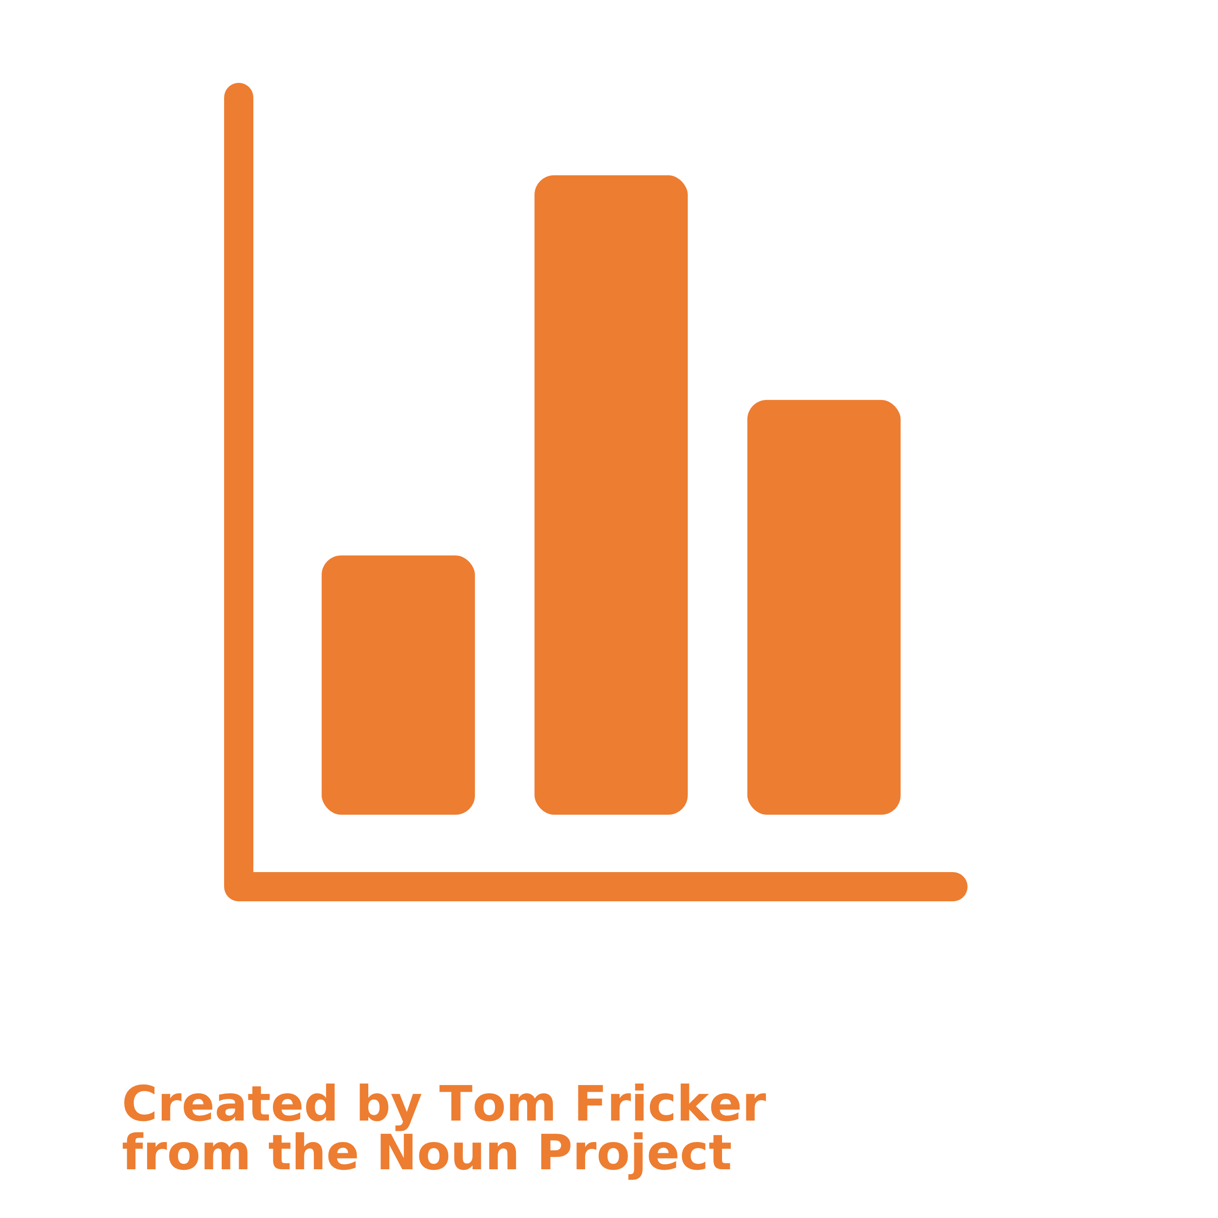
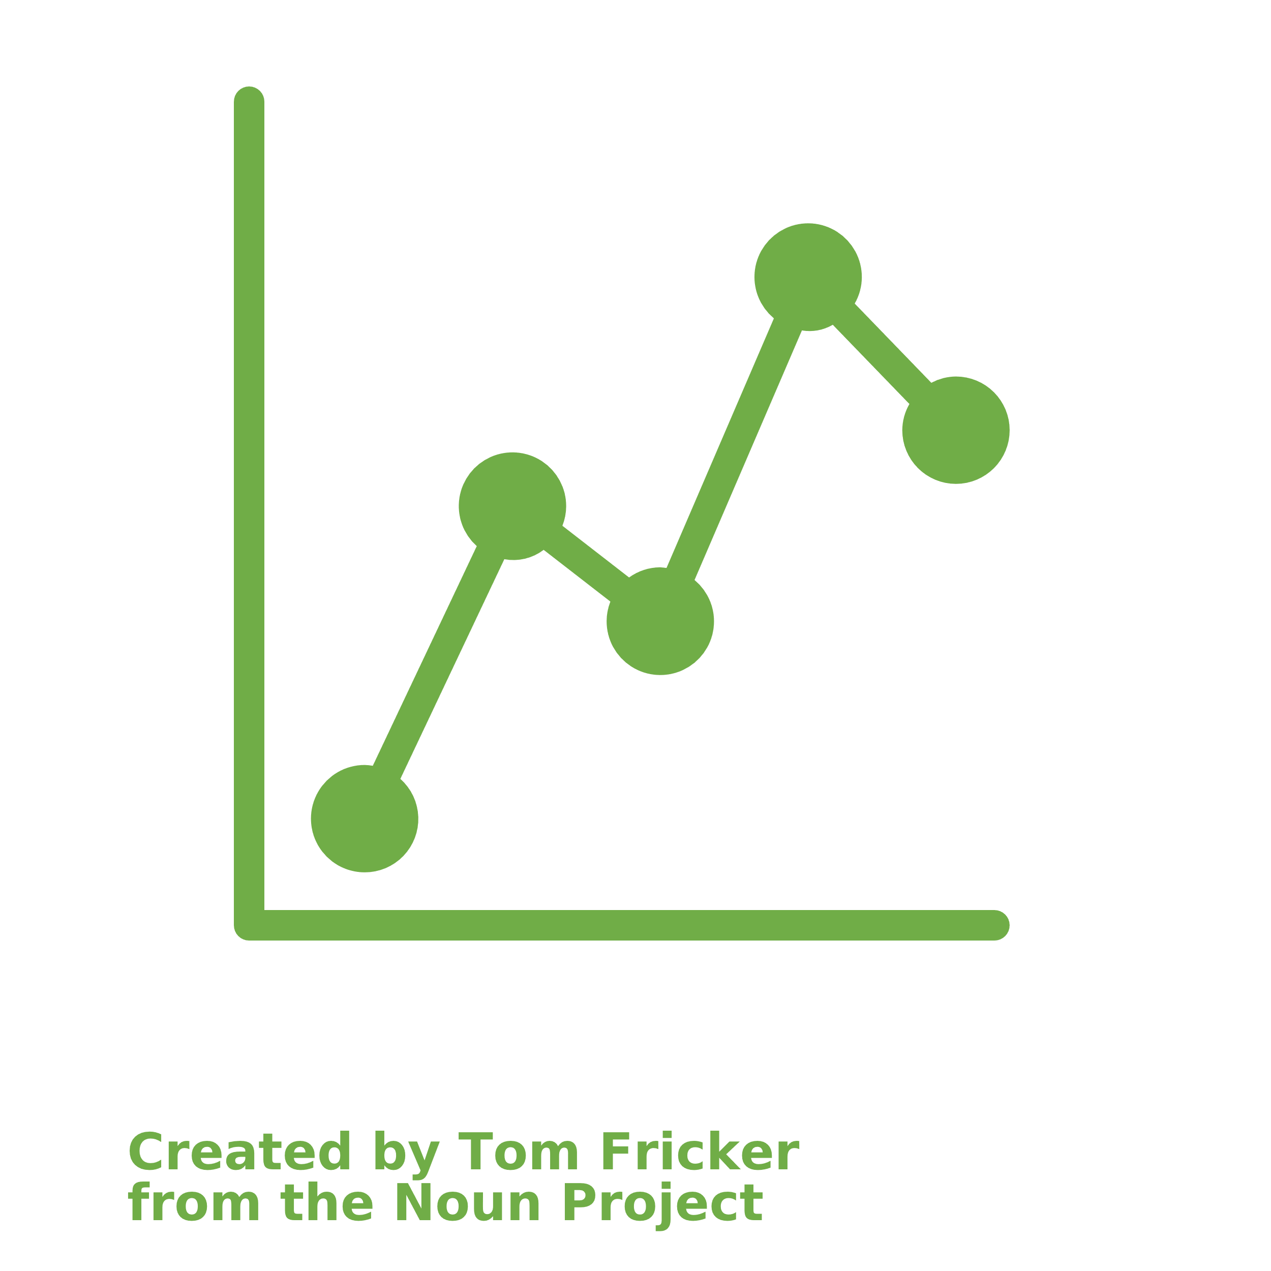
EDA with Data Visualization
Flight number x Payload
Flight number x ite
Payload x Launch Site
Orbit x Flight number
Payload x Orbit
Orbit x Payload
Mean x Orbit
Success Rate x Year
BarPlot
Used to try to identify correlation between orbit type (categorical variable) and the rate of successfull (quantitative variables).
TimeSeries LinePlot
Try to find Evolution of a variable over time.
Scatterplot
Used to try to identify correlation between its quantitative variables.
Obs: Correlation does not mean casuality
Link to GitHub

Slide 12
EDA with SQL
Read csv files
Unique launch sites in the space mission
Launch sites begin with the string 'CCA’
Total payload mass carried by boosters launched by NASA (CRS)
Load on SQL DB
Average payload mass carried by booster version F9 v1.1
Date when the first successful landing outcome in ground pad
Names of the boosters which have success in drone ship and have payload mass greater than 4000 but less than 6000
Run EDA throught SQL queries
Total number of successful and failure mission outcomes
Names of the booster_versions which have carried the maximum payload mass
Failed landing_outcomes in drone ship, their booster versions, and launch site
Rank the count of landing outcomes (such as Failure (drone ship) or Success (ground pad)) bvy date
Link to GitHub

Slide 13
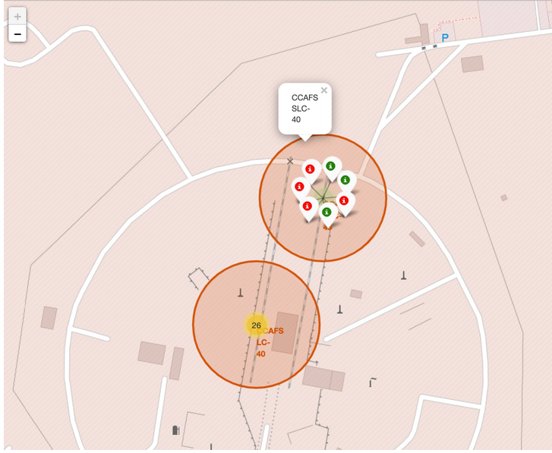
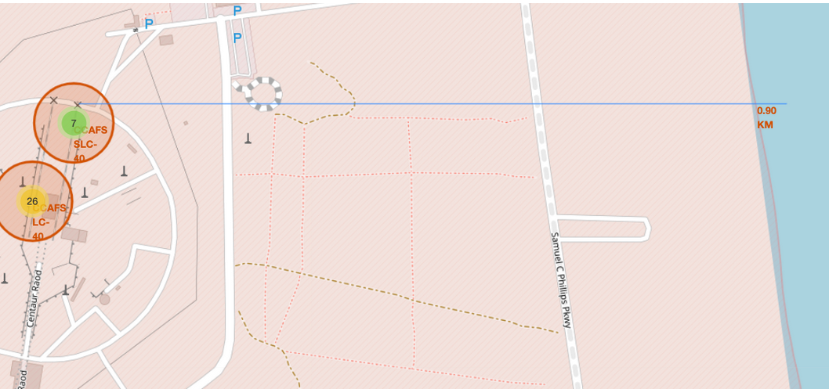
Build an Interactive Map with Folium
OBJETIVE: Extract some info by maps, using geometrical forms and labels.
Mark all launch identify its site.
Add a label about the success of the landing
Find some POIs near each site, draw a straight line to them and calculate the distance.
Example of some trends in which the Launch Site is situated in:
Are launch sites in close proximity to railways? No
Are launch sites in close proximity to highways? No
Are launch sites in close proximity to coastline? Yes
Do launch sites keep certain distance away from cities? Yes
Link to GitHub

Slide 14
Build a Dashboard with Plotly Dash
Objects:
dropdown list to enable Launch Site selection
pie chart to show the total successful launches count for all sites
slider to select payload range
scatter chart to show the correlation between payload and launch success
Callbacks for interactions:
callback function for “site_dropdown” as input, “success-pie-chart” as output
callback function for “site_dropdown” and “payload-slider” as inputs, `success-payload-scatter-chart` as output
For selection
It shows the relationship between two variables. It is the best method to show you a non-linear pattern. The range of data flow, i.e. maximum and minimum value, can be determined.
For selection
Display relative proportions of multiple classes of data. Size of the circle can be made proportional to the total quantity it represents.
Link to GitHub

Slide 15
Predictive Analysis (Classification)
Build Model
Evaluate Model
Improving Model
Compare Model
Load dataset
Transform Data
Training/test split
Choose algorithms
Set hyperparameters
GridSearchCV
Fit the GridSearchCV objects and train our dataset.
Check accuracy for each model
Get tuned hyperparameters
Plot Confusion Matrix
Feature Engineering
Algorithm Tuning
Compare accuracy scores
Choose the algorithm with best result
Link to GitHub

Slide 16
Results
Exploratory data analysis results
Interactive analytics demo in screenshots
Predictive analysis results

Slide 17

Section 2

Slide 18
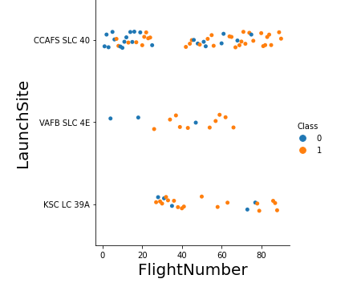
Flight Number vs. Launch Site
The more amount of flights at a launch site the greater the success rate at a launch site

Slide 19
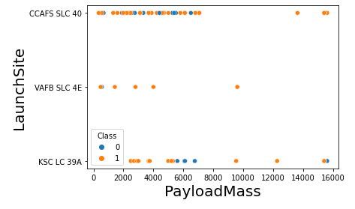
Payload vs. Launch Site
The greater the payload mass for Launch Site CCAFS SLC 40 the higher the success rate for the Rocket.
There is not quite a clear pattern to be found using this visualization to make a decision if the Launch Site is dependant on Pay Load Mass for a success launch.

Slide 20
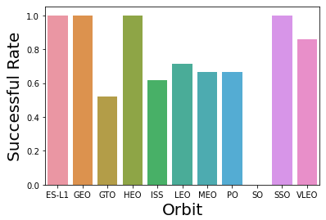
Success Rate vs. Orbit Type
Orbit GEO,HEO,SSO,ES-L1 has the best Success Rate

Slide 21
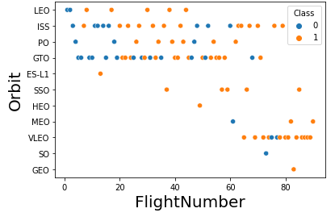
Flight Number vs. Orbit Type
You should see that in the LEO orbit the Success appears related to the number of flights; on the other hand, there seems to be no relationship between flight number when in GTO orbit.

Slide 22
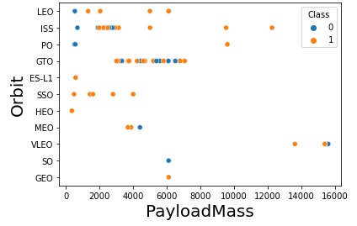
Payload vs. Orbit Type
You should observe that Heavy payloads have a negative influence on GTO orbits and positive on GTO and Polar LEO (ISS) orbits.

Slide 23
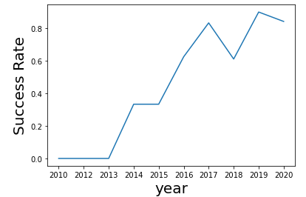
Launch Success Yearly Trend
Success rate since 2013 kept increasing until 2020

Slide 24
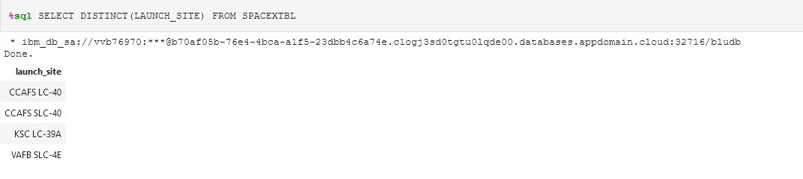
All Launch Site Names
Using the word DISTINCT in the query means that it will only show Unique values in the LAUNCH_SITE column from SPACEXTBL
Using the word DISTINCT in the query means that it will only show Unique values in the LAUNCH_SITE column from SPACEXTBL

Slide 25
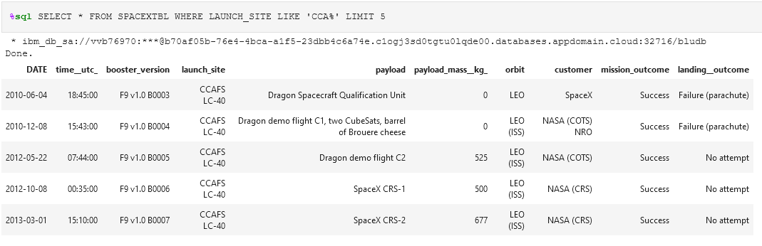
Launch Site Names Begin with 'CCA'
Using the word TOP 5 in the query means that it will only show 5 records from tblSpaceX and LIKE keyword has a wild card with the words ‘CCA%’ the percentage in the end suggests that the Launch_Site name must start with CCA.

Slide 26
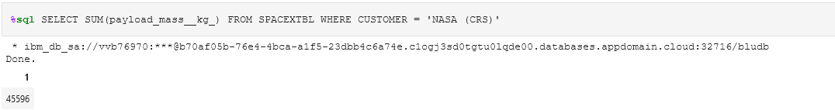
Total Payload Mass
Using the function SUM summates the total in the column PAYLOAD_MASS_KG_
The WHERE clause filters the dataset to only perform calculations on Customer NASA (CRS)

Slide 27
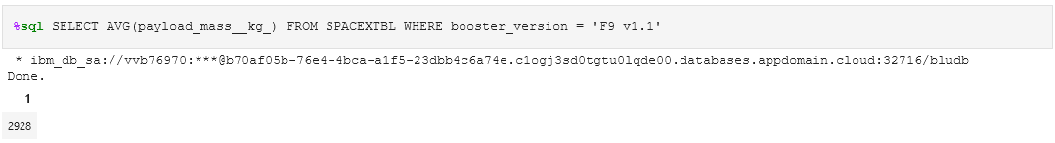
Average Payload Mass by F9 v1.1
Using the function AVG works out the average in the column PAYLOAD_MASS_KG_ The WHERE clause filters the dataset to only perform calculations on Booster_version F9 v1.1

Slide 28
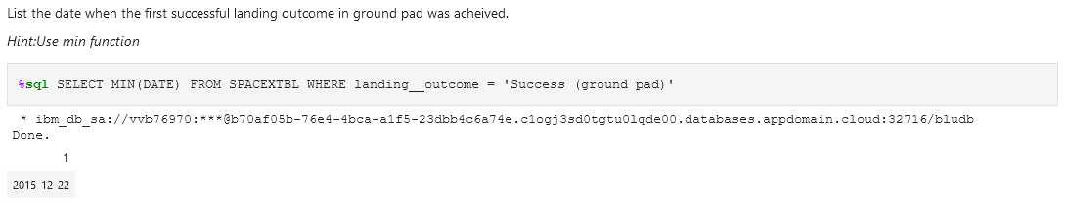
First Successful Ground Landing Date
Using the function MIN works out the minimum date in the column Date The WHERE clause filters the dataset to only perform calculations on landing_outcome Success (drone ship)

Slide 29
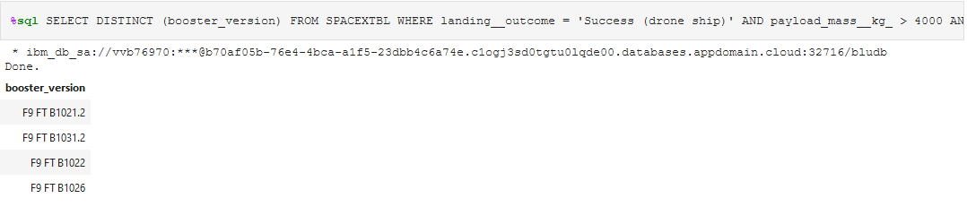
Successful Drone Ship Landing with Payload between 4000 and 6000
Selecting only booster_version The WHERE clause filters the dataset to landing_outcome = Success (drone ship) The AND clause specifies additional filter conditions payload_mass_kg_ > 4000 AND payload_mass_kg_ < 6000

Slide 30
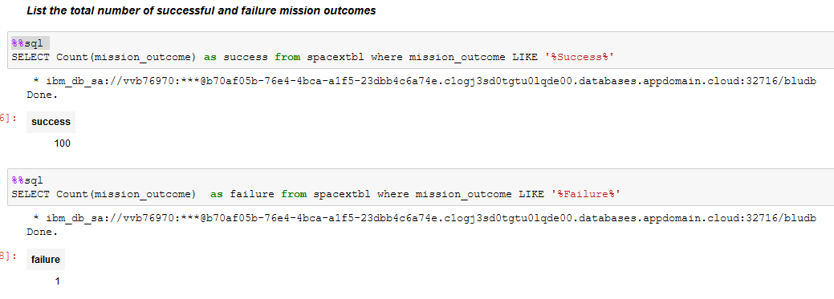
Total Number of Successful and Failure Mission Outcomes
The mission outcome has labels with the words success and failure. To calculate the number of each one, I used two queries, looking for these words, associate with count function.

Slide 31
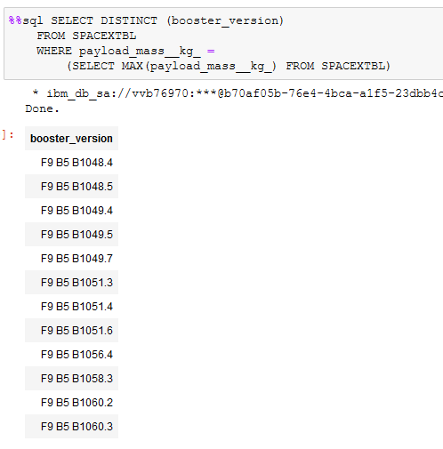
Boosters Carried Maximum Payload
Using the word DISTINCT in the query means that it will only show Unique values in the BOOSTER_VERSION column from SPACEXTBL
GROUP BY puts the list in order set to a certain condition.
DESC means its arranging the dataset into descending orde

Slide 32
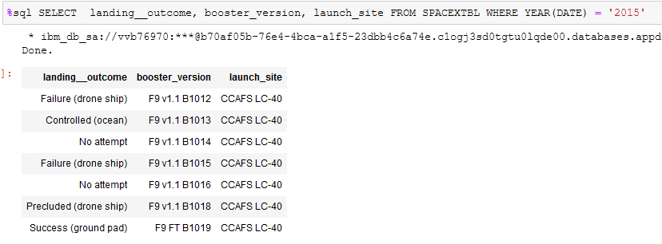
2015 Launch Records
Using the native function YEAR, I filter the data for the 2015 data.

Slide 33
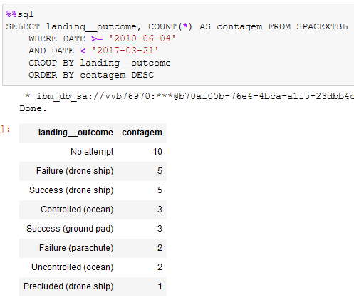
Rank Landing Outcomes Between 2010-06-04 and 2017-03-20
Function COUNT counts records in column
WHERE filters data
LIKE (wildcard)
AND (conditions)
AND (conditions)

Slide 34

Section 3

Slide 35
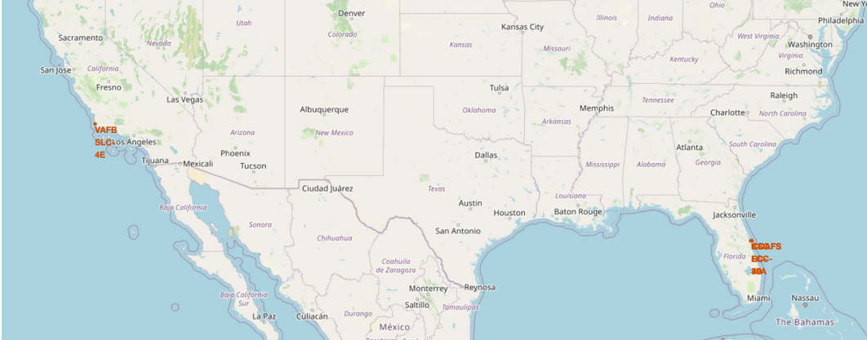
Where are the Launch Sites?
Despite the multiple launch sites, they are all located at US Coasts, in Florida and California.

Slide 36
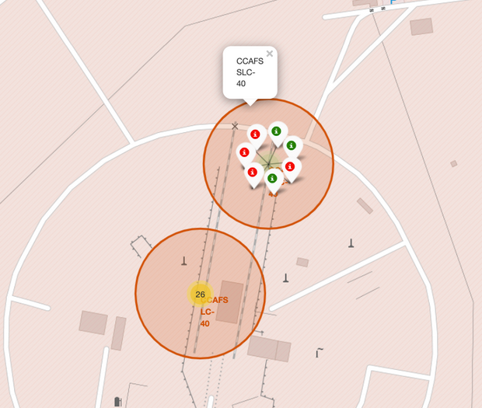
Visualize the Success and Failure
Red for failure
Green for success

Slide 37

Where are the POIs?
The nearest coastline for CCAFS SLC-40 is less than 1km of distance.

Slide 38

Section 4

Slide 39
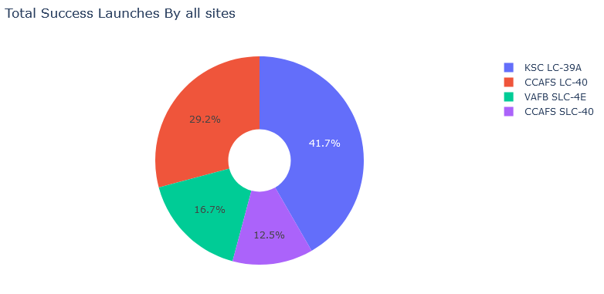
Success Launches by site
KSC LC-39A has the majority of success launches, follow by CCAFS LC-40. Together, they represent mores than 70% of success launches

Slide 40
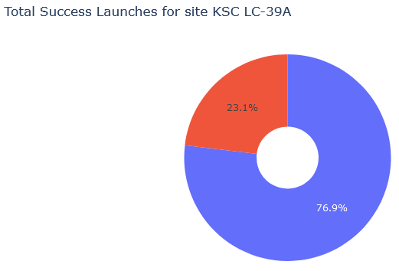
KSC LC-39A is the best performer launch site
KSC LC-39A perform above 75% of success for its launchs, indicating that launch a rocket from this site could improve the chances of success.

Slide 41
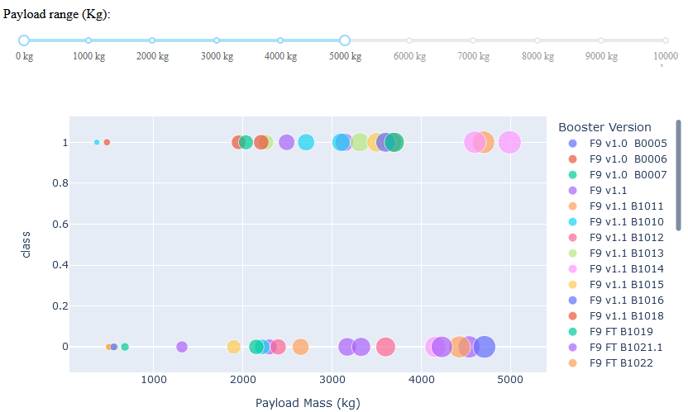
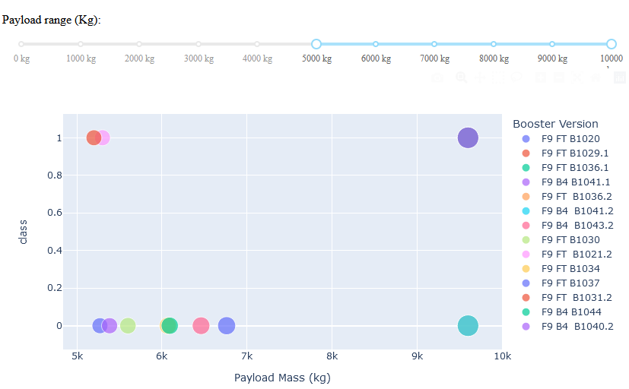
Payload mass reduce its chance of success
Payload mass 0kg – 5000kg
Payload mass 5000kg – 10000kg
Success rates for low weighted payloads are higher than the heavy weighted payloads

Slide 42

Section 5

Slide 43
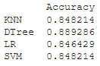
Classification Accuracy
As marked on a side plot, the Decision Tree was the best performer between the analyzed algorithms.

Slide 44
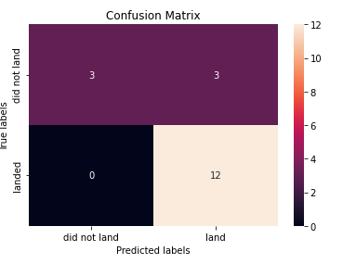
Confusion Matrix
At the decision tree model we have:
We have 0 false negatives
And 3 false positives, which is the biggest problem of this model.

Slide 45
Conclusions
We can see that KSC LC-39A had the most successful launches from all the sites
Orbit GEO,HEO,SSO,ES-L1 has the best Success Rate
Low weighted payloads perform better than the heavier payloads
The improving success rate over the years indicate a learning curve.
The decision Tree Classifier Algorithm is the best for Machine Learning for this dataset after tunning the hyperparameters.

Slide 46


